Slide 1
William Stallings Computer Organization and Architecture
6th Edition
Chapter 9
Computer Arithmetic

Slide 2
Arithmetic & Logic Unit
Does the calculations
Everything else in the computer is there to service this unit
Handles integers
May handle floating point (real) numbers
May be separate FPU (maths co-processor)

Slide 3
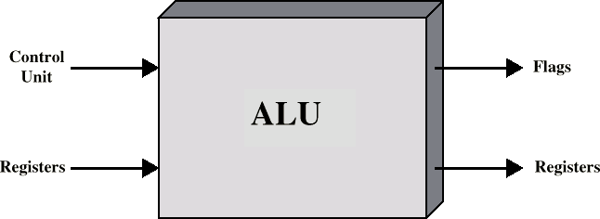
ALU Inputs and Outputs

Slide 4
Addition and Subtraction
Normal binary addition
Monitor sign bit for overflow
Take twos compliment of substahend and add to minuend
— i.e. a - b = a + (-b)
So we only need addition and complement circuits
A | B | Sum
0 | 0 | 0
0 | 1 | 1
1 | 0 | 1
1 | 1 | 0, Carry 1
1 | 1 and 1(Prev carry) | Sum=1,Carry=1

Slide 5
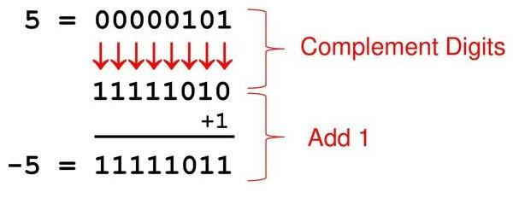
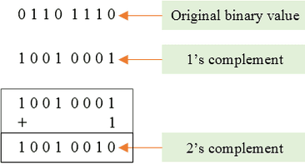
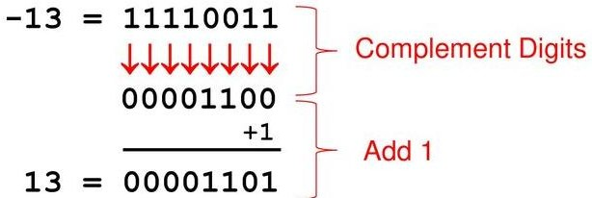
Example of 2’s Compliment

Slide 6
Find 2’s compliment
1000
0100
111001
101010
100000

Slide 7
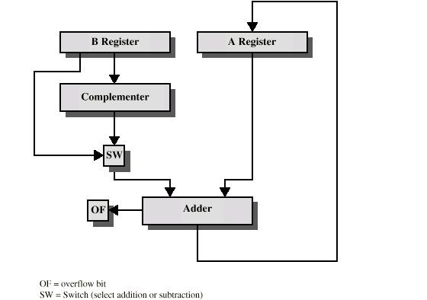
Hardware for Addition and Subtraction

Slide 8
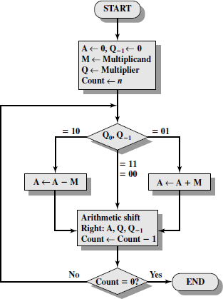
Booth’s Algorithm

Slide 9
`
Q0 | Q-1 | Result
0 | 0 | Only shift
1 | 1
0 | 1 | A=A + M ,then shift
1 | 0 | A= A – M , then shift
M =7
Q =3
M = 0 1 1 1
Q = 0 0 1 1
- M = 1 0 0 1

Slide 10




Example of Booth’s Algorithm:7(M)*3(Q)
Answer is in A and Q→0001 0101 =21

Slide 11
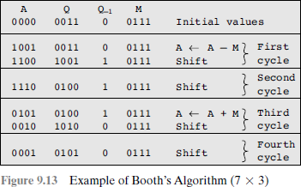

Slide 12
Examples-size of n determines answer
Solve using Booths Algorithm A. M = 5 , Q = 5
B. M = 12, Q = 11
C. M = 9, Q = - 3
D. M = -13 ( 0011 ) , Q = 6
-M=13 (1101)
A. M = -19 , Q = -20

Slide 13
Division
More complex than multiplication
Negative numbers are really bad!
Based on long division

Slide 14
Division of Unsigned Binary Integers
00001101 1011 10010011
Quotient
Dividend
Divisor
1011
001110
1011
Partial Remainders
001111
1011
100
Remainder

Slide 15
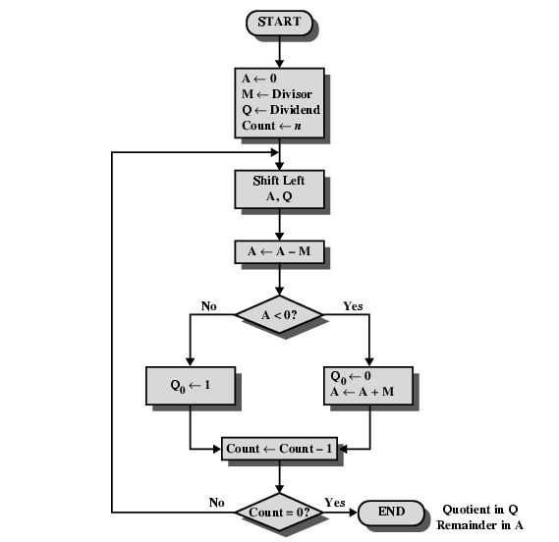
Flowchart for Restoring Division

Slide 16
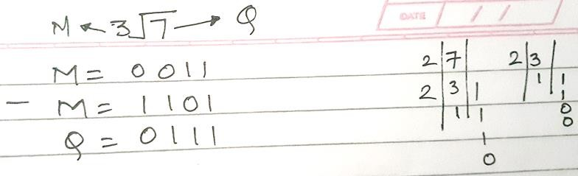
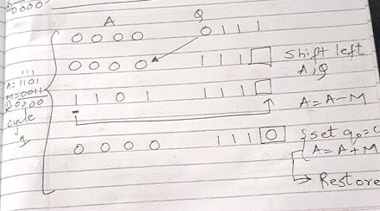

Slide 17
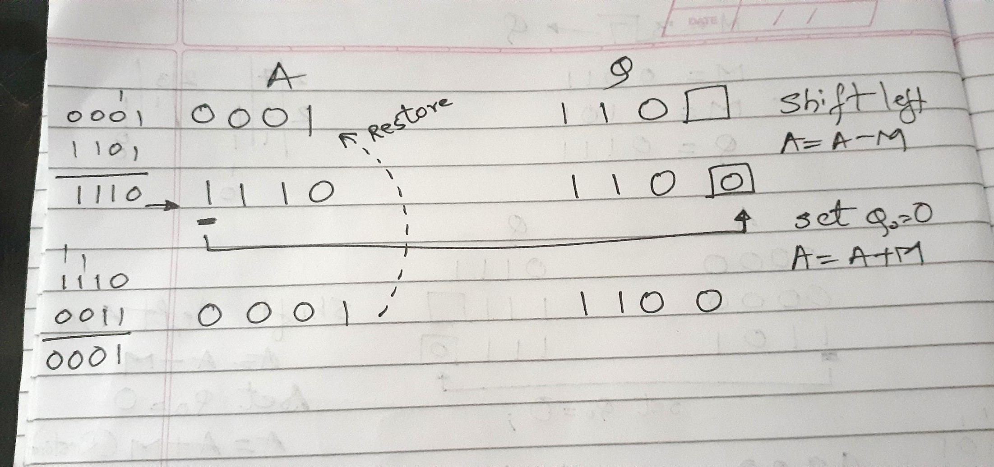

Slide 18
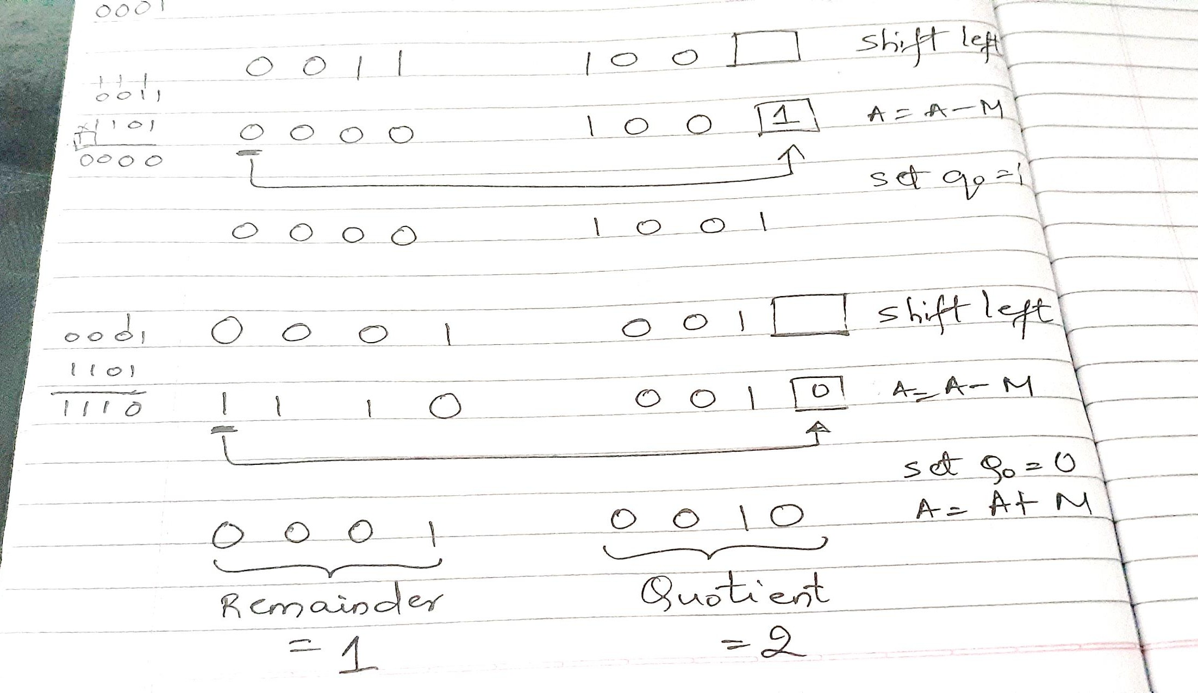

Slide 19
Solve by restoring division
M= 0 1 1 0 1 1
Q= 1 1 0 1 1 1

Slide 20
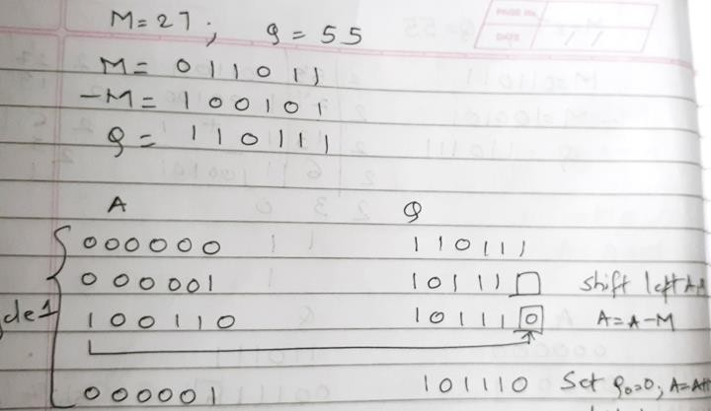

Slide 21
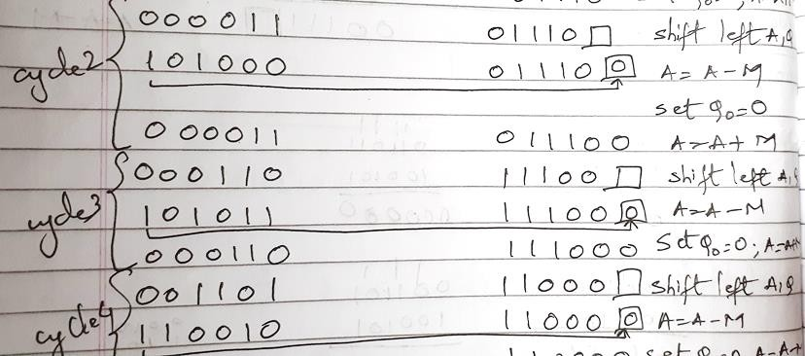

Slide 22
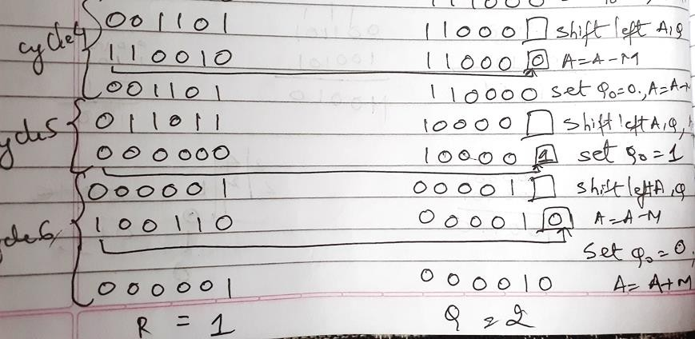

Slide 23
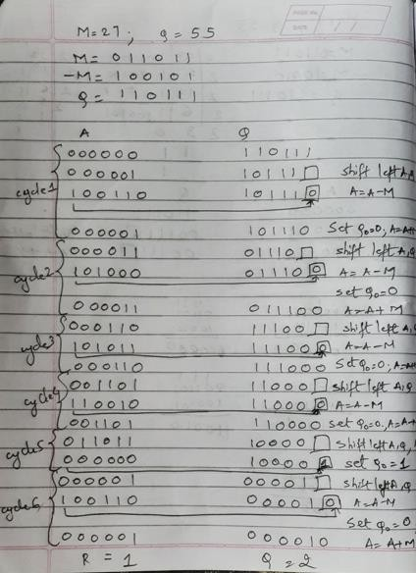

Slide 24
Solve using Restoring Division
A. M = 5 , |  | Q = 5 ,
B. M = 12, |  | Q = 26,
C. M = 9, |  | Q = 19 ,
D. M = 32 | , | Q = 59
E. M = 17 | , | Q = 42,

Slide 25
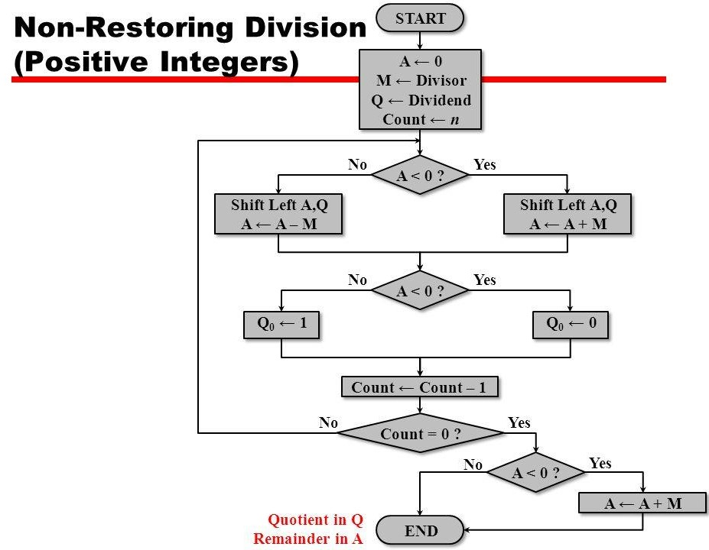
1
0
0
1

Slide 26
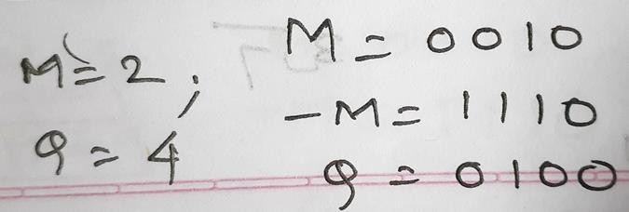
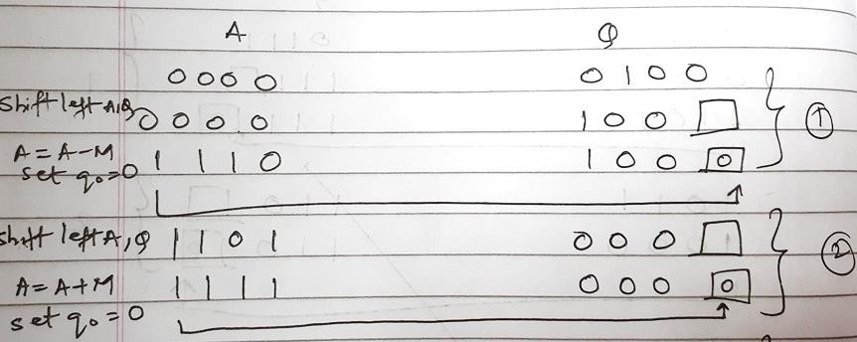

Slide 27
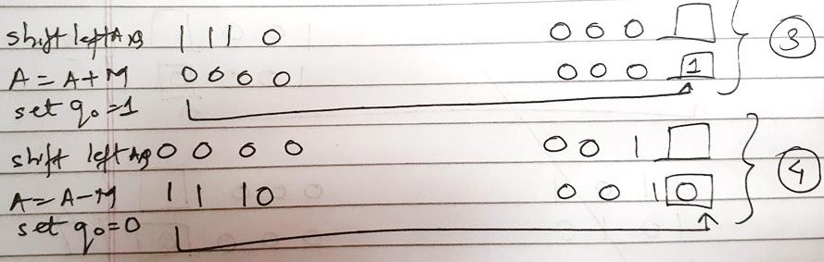
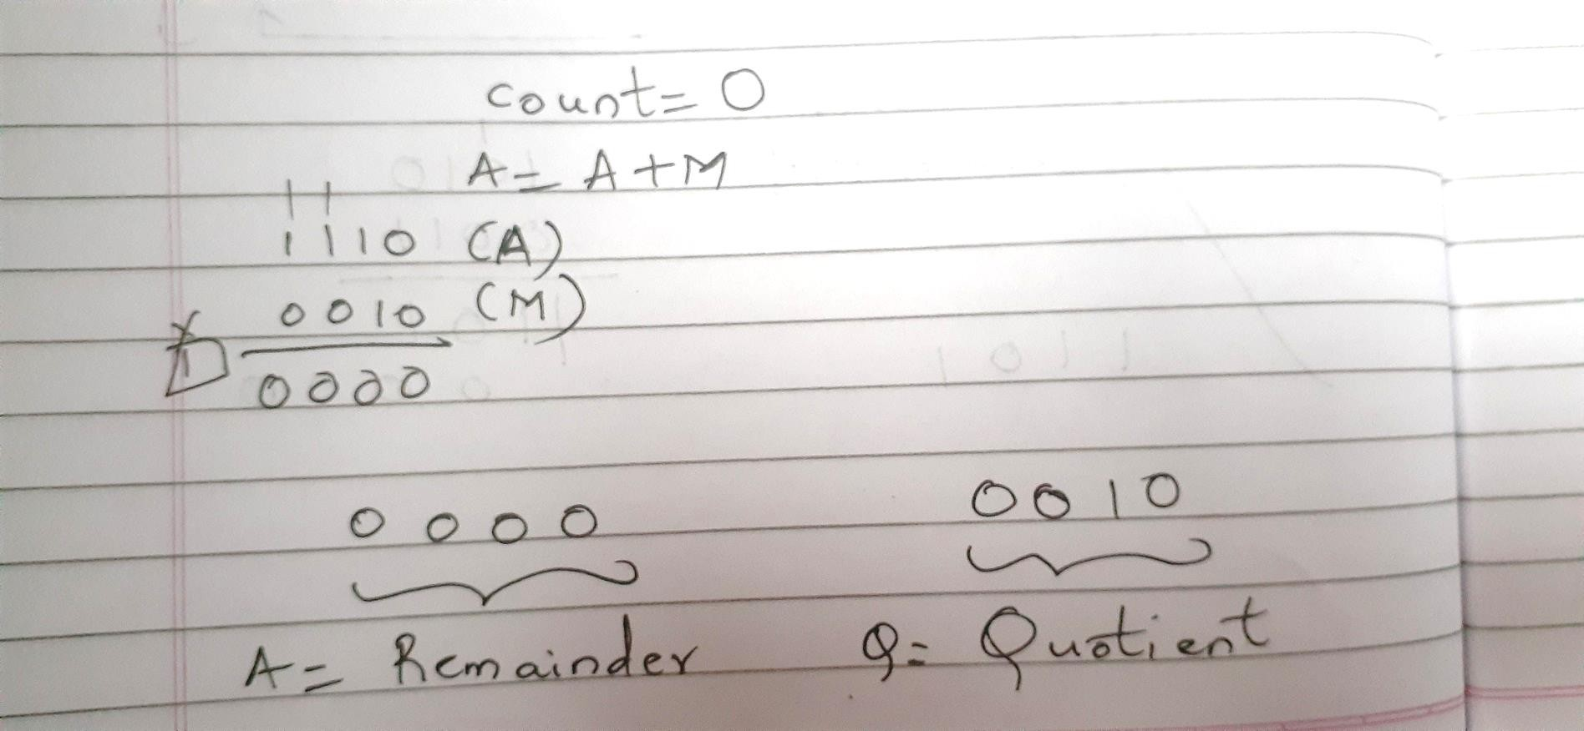

Slide 28
Solve using Non Restoring
A. M = 5 , |  | Q = 5.
B. M = 12, |  | Q = 26.
C. M = 9, |  | Q = 19
D. M = 32 | , | Q = 59,.
E. M = 17 | , | Q = 42.

Slide 29
Booths Recoding / Bit pair recording
STEPS

Slide 30
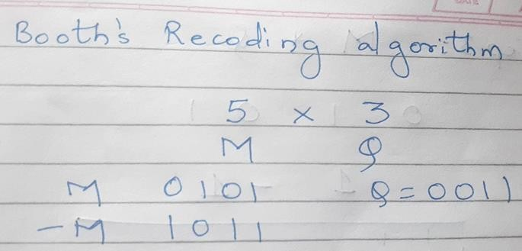

Slide 31
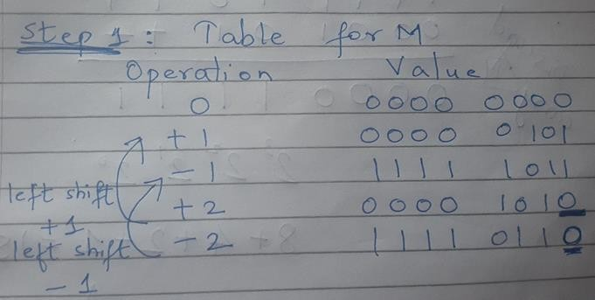

Slide 32
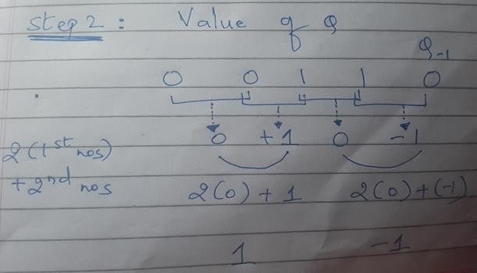

Slide 33
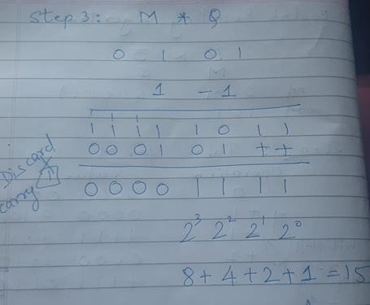

Slide 34
Solve using Booths Recoding
1. M= 5 , Q = 4 (4 bits)= 00010100 (20)
2. M=9 , Q = -6 (5 bits)=11110 01010 (-54)
3. M=15 , Q=-10 (5 bits)=11011 01010(-150)
4. M= -13 ,Q = -20 (6 bits )=000100000100(260)

Slide 35
IEEE 754
Standard for floating point storage
32 and 64 bit standards
8 and 11 bit exponent respectively
Extended formats (both mantissa and exponent) for intermediate results
– IEEE Standard 754 floating point is the most common representation today for real numbers on computers, including Intel-based PC’s, Macs, and most Unix platforms.

Slide 36
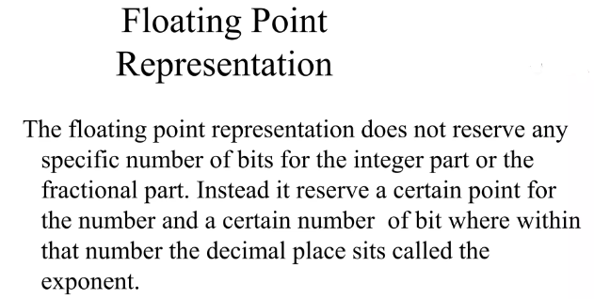

Slide 37
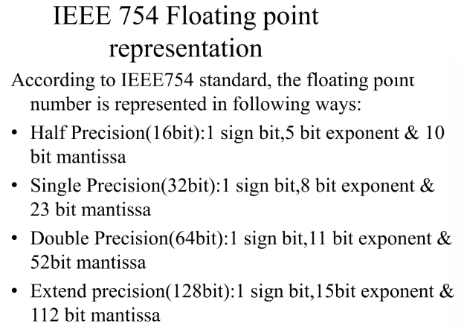

Slide 38
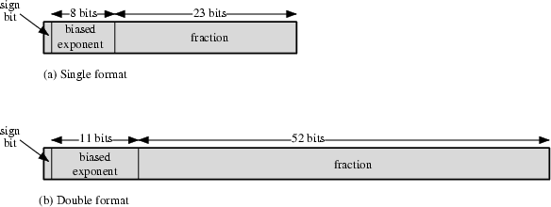
IEEE 754 floating point representation
(1.N)2^{E-127}
32 BIT
64 BIT
_{(1.N)2}E-1023

Slide 39
Steps
1. Convert Decimal to Binary
2. Normalization
— Rewriting Step 1 into (1.N) form
— Ex: 1 1 1 . 0 1 1 = 1 . 1 1 0 1 1 X 2 ²
Exponent
— Ex: 0 . 0 0 0 1 0 = 0 0 0 0 1 . 0 X 2 -⁴
3.Biasing
— Applying Single Precision (E – 1 2 7) & Double Precision ( E – 1 0 2 3 ) on exponent from Step 2
4. Representation in Single (32 bit )and Double Precision (64 bit ) Format

Slide 40
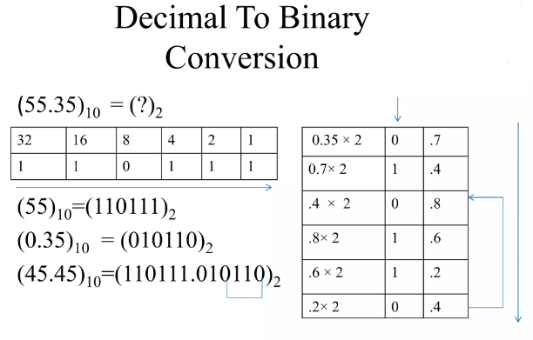

Slide 41
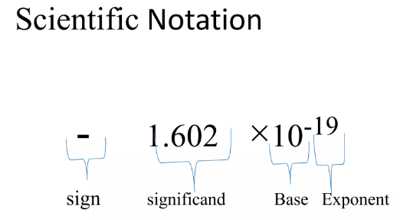

Slide 42
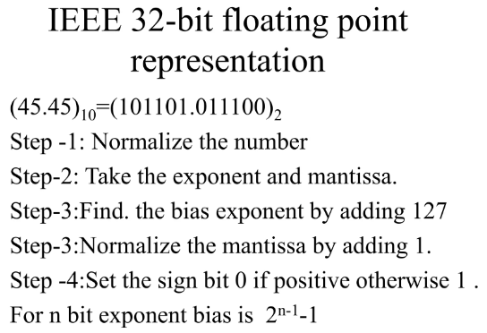

Slide 43
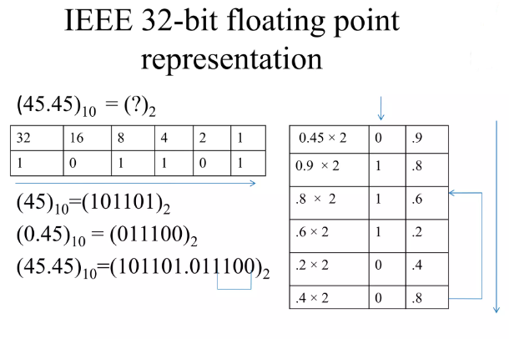

Slide 44
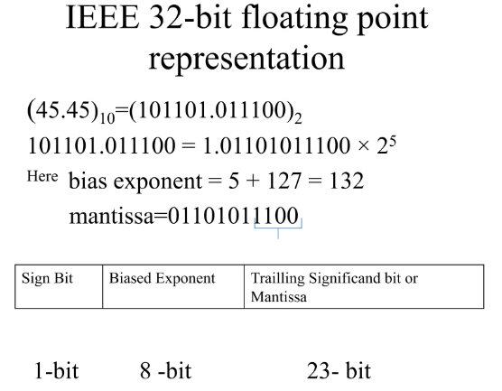

Slide 45
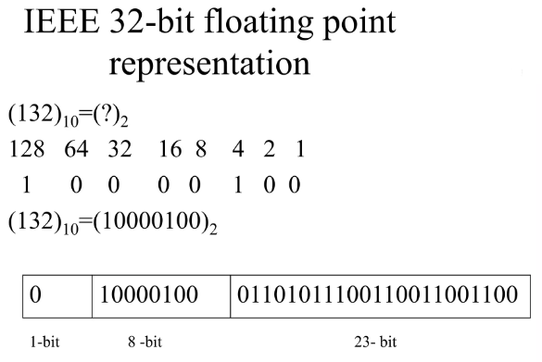

Slide 46
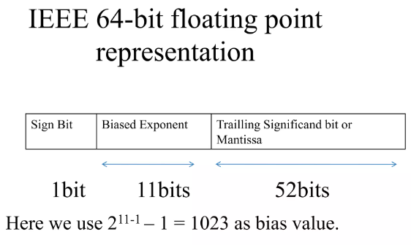

Slide 47
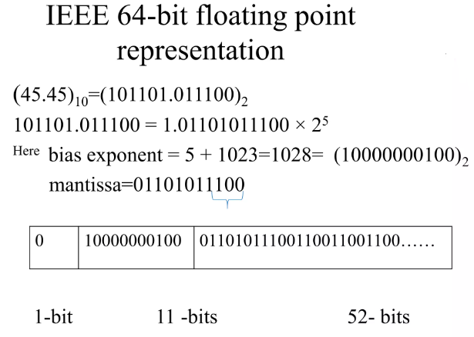

Slide 48
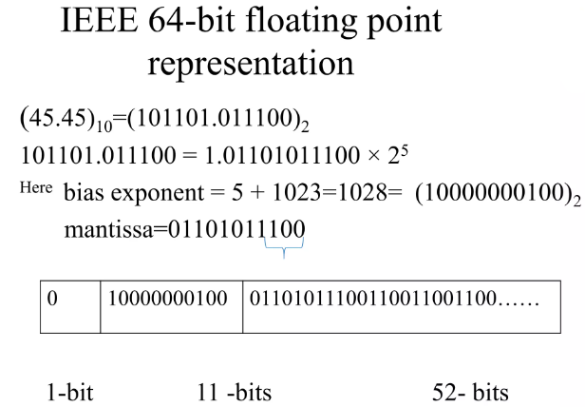

Slide 49
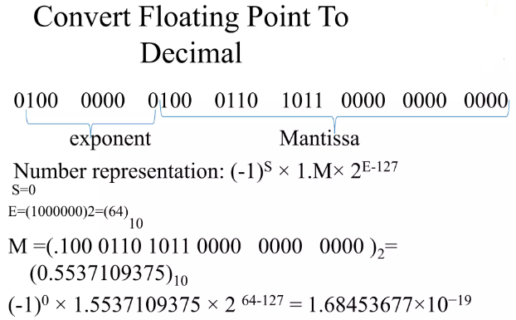

Slide 50
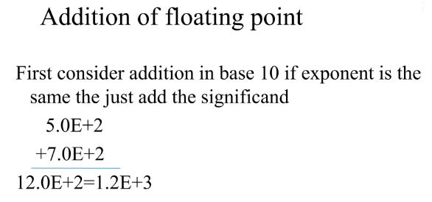

Slide 51
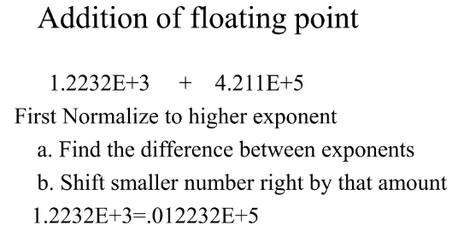

Slide 52
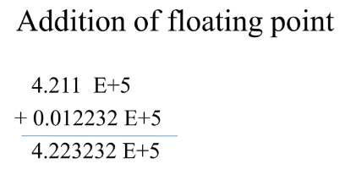

Slide 53
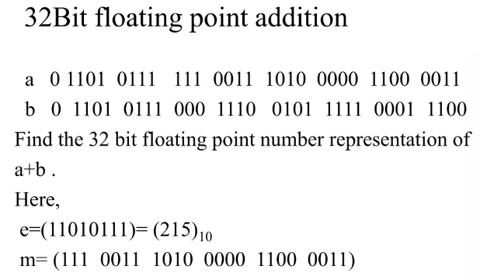

Slide 54
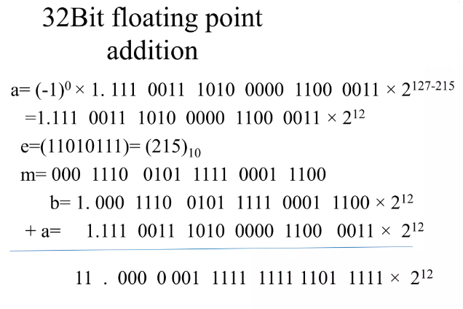

Slide 55
Sample mix problems-Kindly refrain referring to flowchart.
1. Booth’s Algorithm = 000 100 000 100(260)
A= 110011 (Multiplicand ) B= 101100 (Multiplier)
Booth’s Recoding = 11011 01010
M= ( 15 ) Q= ( -10 )
Non Restoring Division
M=11 , Q= 21 , A= 01010 , Q= 00001
Restoring Division
M=14 , Q= 15, A=00001 , Q = 00001

Slide 56
4 phases of FP Arithmetic +/-
Check for zeros
Align significands (adjusting exponents)
Add or subtract significands
Normalize result

Slide 57
Floating Point Addition
Add the following two decimal numbers in scientific notation:
8.70 × 10⁻¹ with 9.95 × 10¹
Rewrite the smaller number such that its exponent matches with the exponent of the larger number.
8.70 × 10⁻¹ = 0.087 (Note ! ) × 10¹

Slide 58
Add the mantissas
9.95 + 0.087 = 10.037 and
write the sum 10.037 × 10¹
Put the result in Normalised Form 10.037 × 10¹ = 1.0037 × 10²
(shift mantissa, adjust exponent)

Slide 59
Check for overflow/underflow of the exponent after normalisation
Overflow
The exponent is too large to be represented in the Exponent field
Underflow
The number is too small to be represented in the Exponent field

Slide 60
Round the result
If the mantissa does not fit in the space reserved for it, it has to be rounded off.
For Example: If only 4 digits are allowed for
mantissa
1.0037 × 10² ===> 1.004 × 10²

Slide 61
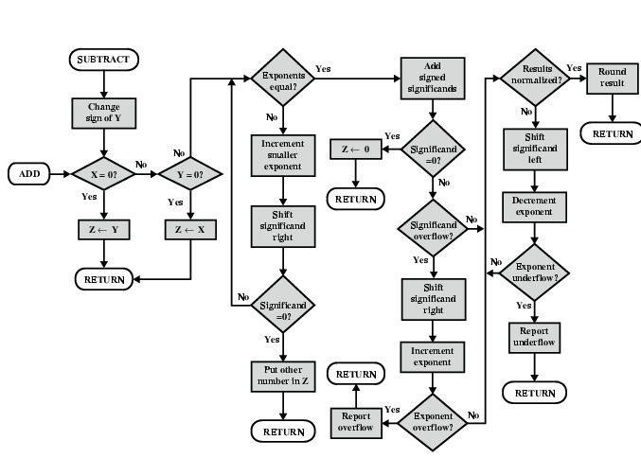
FP Addition & Subtraction Flowchart

Slide 62
FP Arithmetic x/÷
Check for zero
Add/subtract exponents
Multiply/divide significands (watch sign)
Normalize
Round
All intermediate results should be in double length storage

Slide 63
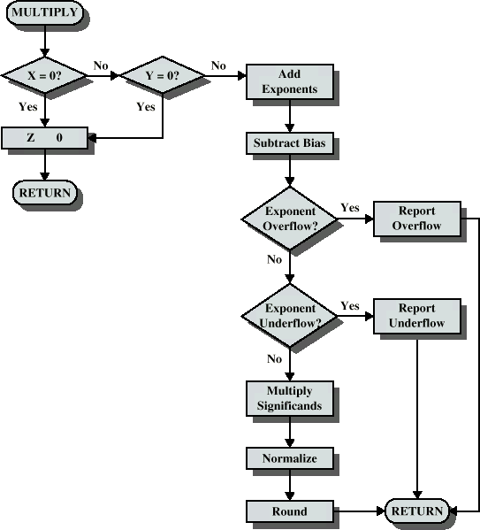
Floating Point Multiplication

Slide 64
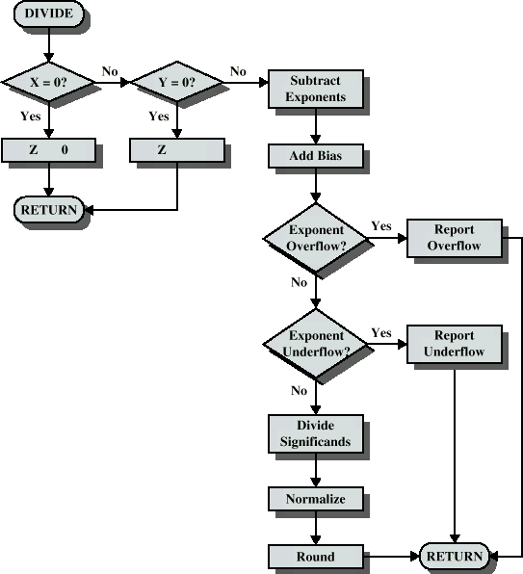
Floating Point Division

Slide 65
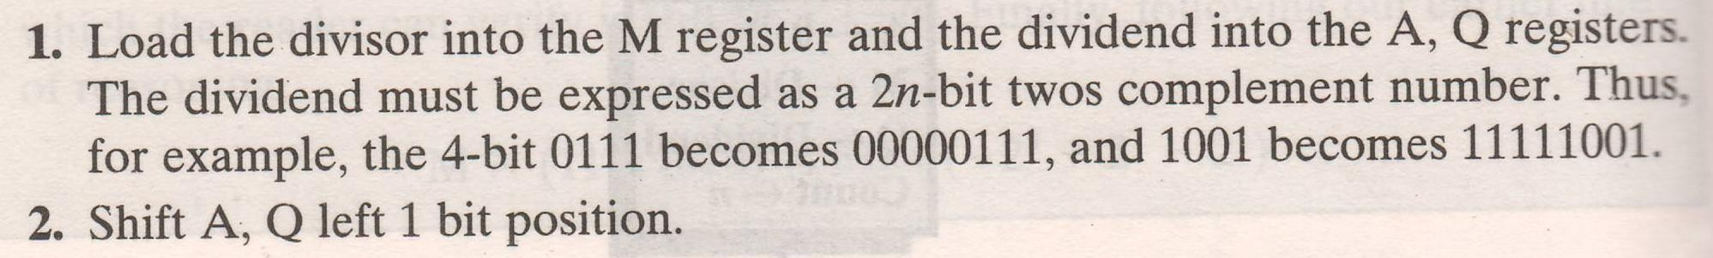
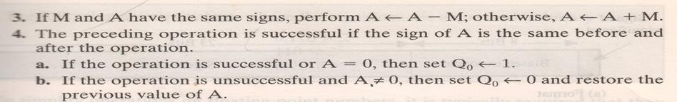

Division of signed numbers

Slide 66
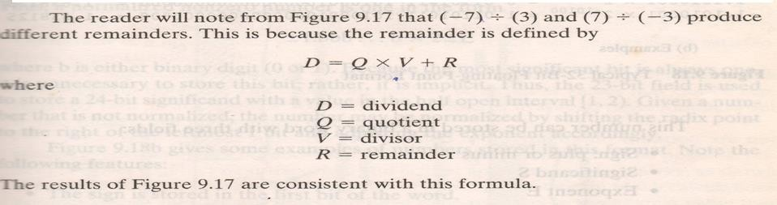

Slide 67
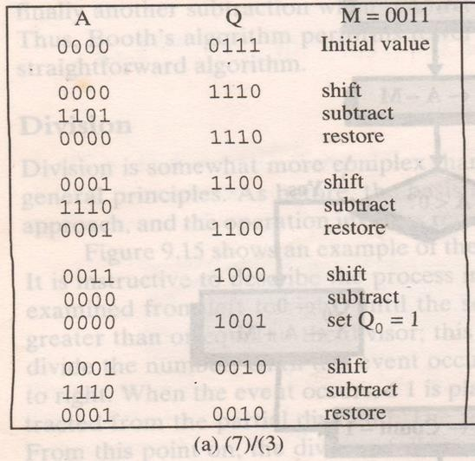

Slide 68
Solve
a) 7 / -3
b) -7 (Q) / 3 (M)
c) -7 (Q) / -3 (M)

Slide 69


Slide 70



Slide 71


Slide 72
Dividend negative → Remainder –ve

